Slide 1
Design of a highly Integrated Dew Point Mirror Hygrometer
Master Thesis
Final Presentation

Slide 2
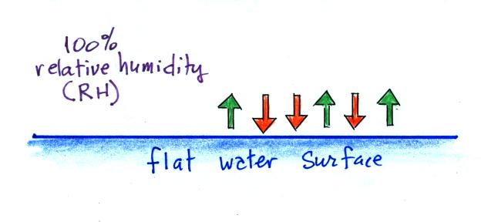
OVERVIEW - humidity
Amount of water in a gas
Described as absolute [kg/m³] or relative [%] value (to equilibrium)
Aim of this work: Development of a Dew Point Hygrometer
cost-efficient
yet highly accurate
[1]
Notes:
Steigen wir direkt ein. Ein Taupunkthygrometer ist ein gerät zur bestimmung der Luftfeuchtigkeit. Die Luftfeuchtigkeit beschreibt erst einmal ganz generell die Menge an Wasserdampf in Luft
Luftfeuchtigkeit: Menge an Wassermolekülen in gasförmigem Zustand in einem Gas bzw. hier in der Luft
Beschrieben als absolutes Maß bspw. In Masse pro Volumen oder relativer Wert im Verhältnis zur maximalen Luftfeuchte
Maximale Luftfeuchte ist bestimmt durch den Equilibriumdampfdruck, also dem Dampfdruck, bei welchem es zwangsläufig zur Kondensation kommt. Dieser ist hauptsächlich von der Temperatur abhängig, wird aber auch durch Druck und Partikel wie Salze beeinflusst. Der Euqilibriumdampfruck steigt mit steigender Temperatur bzw. fällt bei sinkender
Ziel der Arbeit is es einen Taupunkthygrometer zu entwickeln, welcher durch hohe Integration kostengünstig und gleichzeitig mit einer hohen Genauigkeit die Luftfeuchte bestimmen kann.

Slide 3
OVERVIEW - HYGROMETER
Device for measurement of humidity
Different kinds: mechanical, electrical, optical, chemical
Most commonly used today:
Capacitive Sensor | Chilled Dewpoint Mirror
Capacitive measurement using a hygroscopic dielectric | Dew point temperature measurement using a cooled down mirror
+ cheap and small | + ±0.1% RH accuracy
- ±1% RH accuracy | - expensive and large
- long-term drift | - influence on measured gas
Notes:
Um das Ganze mal einzuordnen, erstmal einen kurzen Überblikc über die Methoden der Bestimmung der Luftfeuchte
Zur Einordnung: Ein Hygrometer ist ein Sensor zur Bestimmung der Luftfeuchte

Slide 4
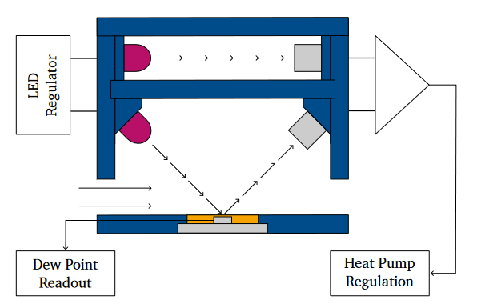
Dew Point Mirror
Mirror integrated thermal sensors (RTD)
Peltier element for cooling
Optical readout of condensate (LED/PD)
Gas flow control
LED
Regulator
Gas Inlet
Dew Point
Readout
Heat Pump
Regulation

Slide 5
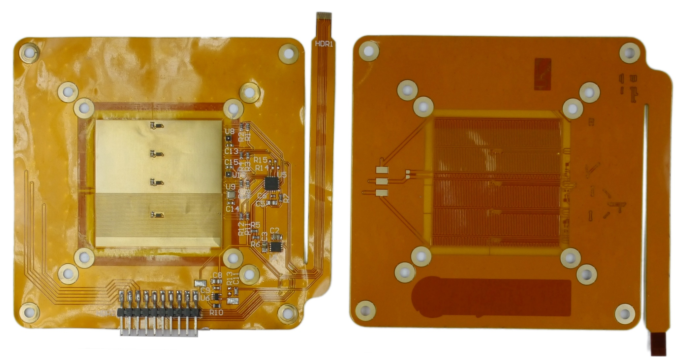
Hardware – Mirror FPC

Slide 6


Hardware – Mirror FPC

Slide 7
Hardware – Mirror FPC

Slide 8
Hardware – Mirror FPC

Slide 9

Hardware – Mirror FPC

Slide 10
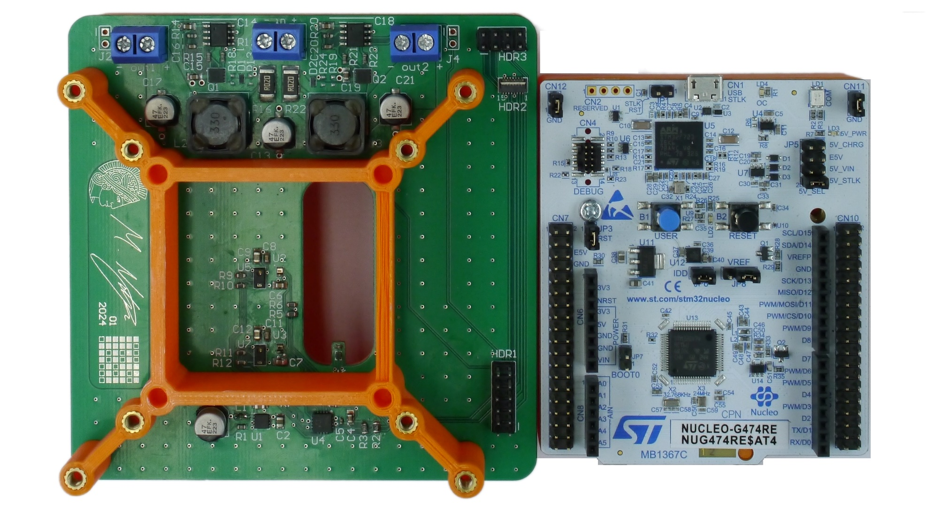
Hardware – BAse PCB

Slide 11


Hardware – BAse PCB

Slide 12

Hardware – BAse PCB

Slide 13
Hardware – BAse PCB

Slide 14
Software
Dew Point Analysis:
Smoothing and interpolation using splines
1st and 2nd order derivatives
Search for significant points
Initial Conditions:
Determine initial readings
Set thresholds for dew presence & abscense
Sensor Readout:
I²C commands for integrated sensors
Timer on interrupt for frequency measurement of capacitor
State & PWM Update:
State depends on thresholds
PWM for heater and cooler depends on temperature error (PID)
Set Initial
Conditions
Initiate Sensor
Readout
Wait & Fetch
Data
State & PWM
Update
Data
Transmission
Dew Point Analysis
Notes:
Da keine onboard analyse: thresholds empirisch so bestimmt, dass definitiv betauung bei abkühlung bzw. kondensation bei erwärmung erfolgt ist

Slide 15
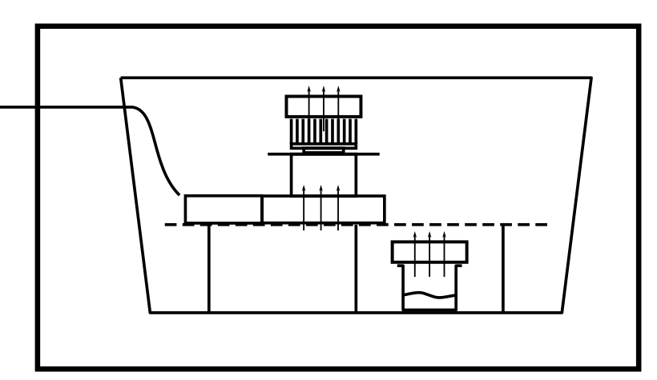
Test Setup
Temperature chamber
Humidity control by deliquescence:
Cooling cycles per measurement [°C/s]: -1.3, -0.4, -0.2, -0.1
Sampling frequency: 5 Hz
temperature chamber
sealed box
data &
power
T [°C] | MgCl2 | Mg(NO3)2 * 6H20 | NaCl | K2SO4
10 | 33.47 | 57.36 | 75.67 | 98.18
25 | 32.78 | 52.89 | 75.29 | 97.59
40 | 31.60 | 48.42 | 74.68 | 96.71
fans
[2]
microcontroller
sensor
solution

Slide 16
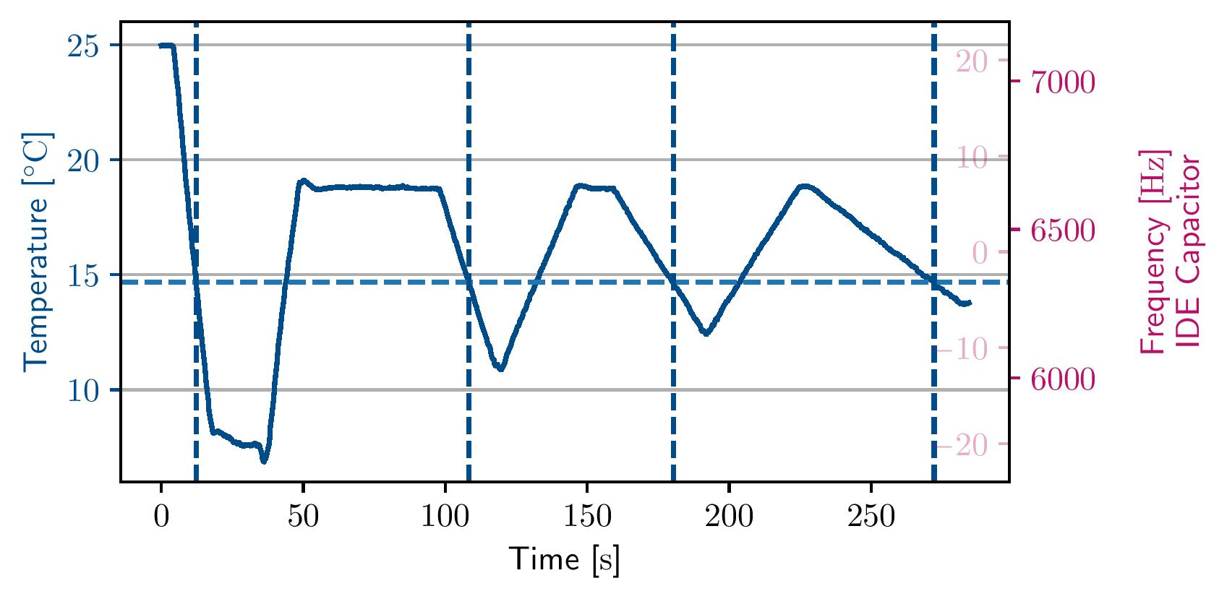
Single Measurement
T=25°C / RH=52.89%

Slide 17
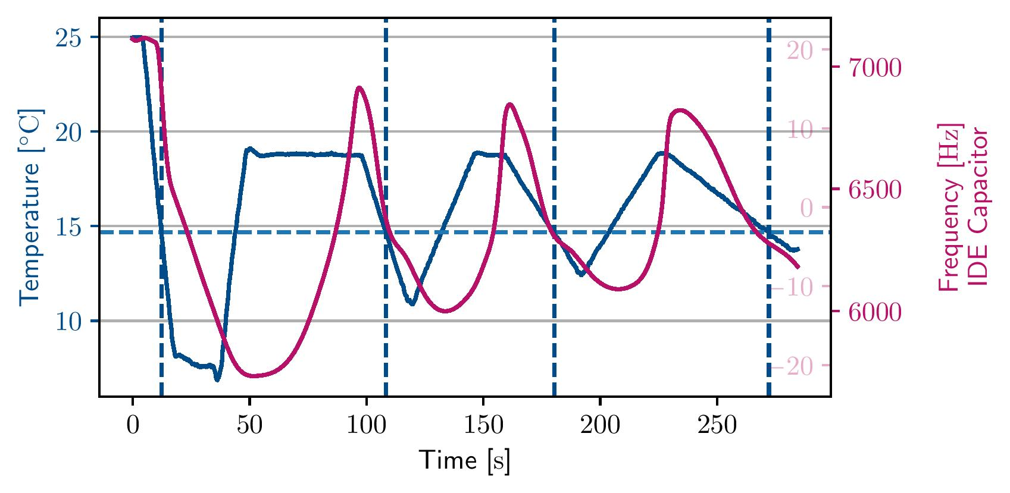
Single Measurement
T=25°C / RH=52.89%

Slide 18
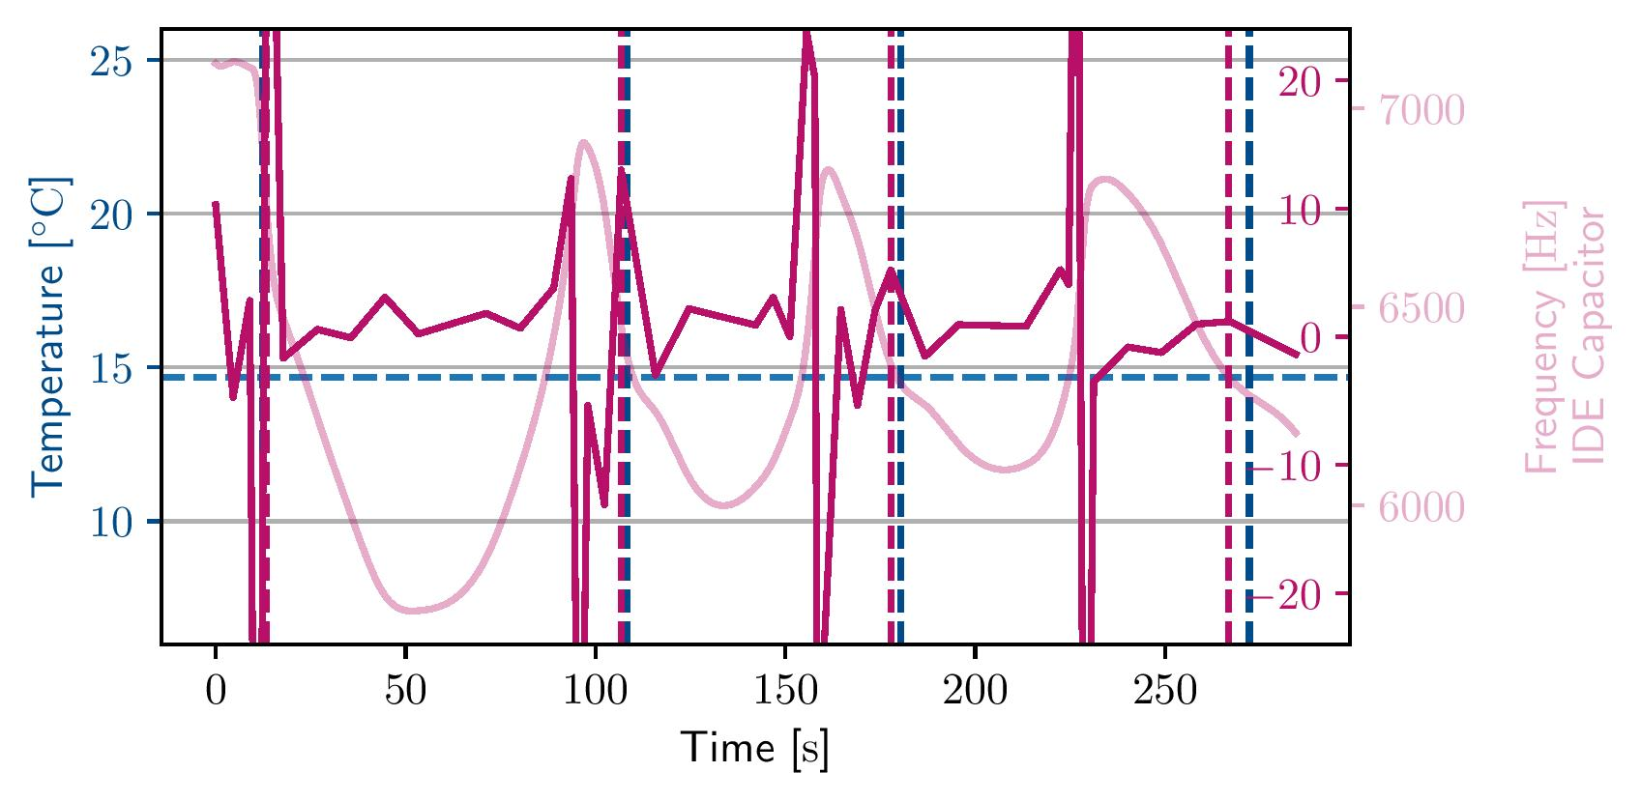
Single Measurement
ddY/dt
T=25°C / RH=52.89%

Slide 19
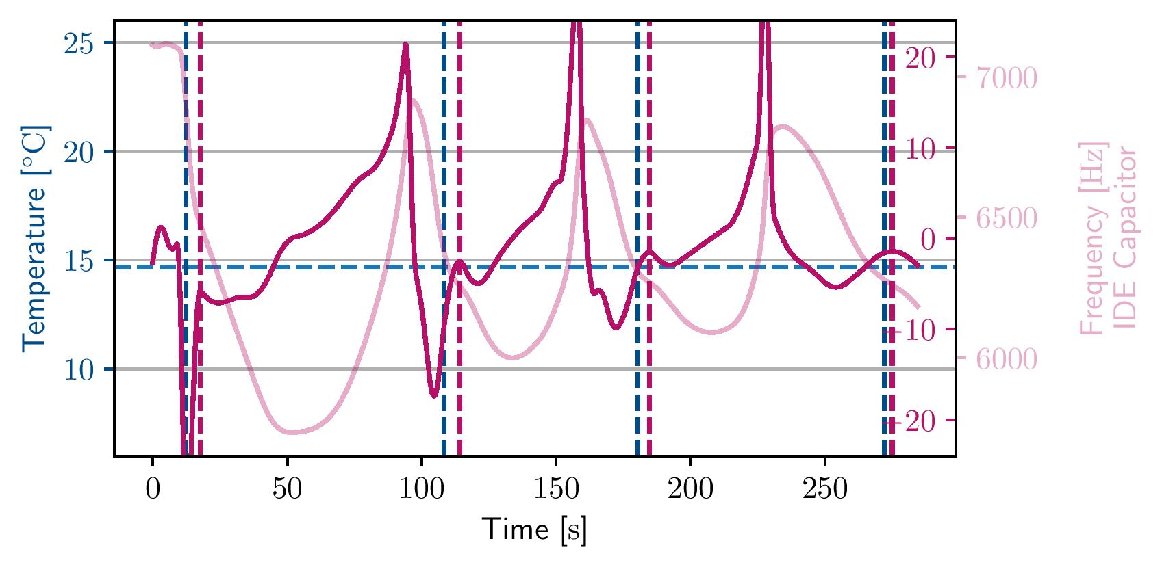
Single Measurement
dY/dt
T=25°C / RH=52.89%

Slide 20
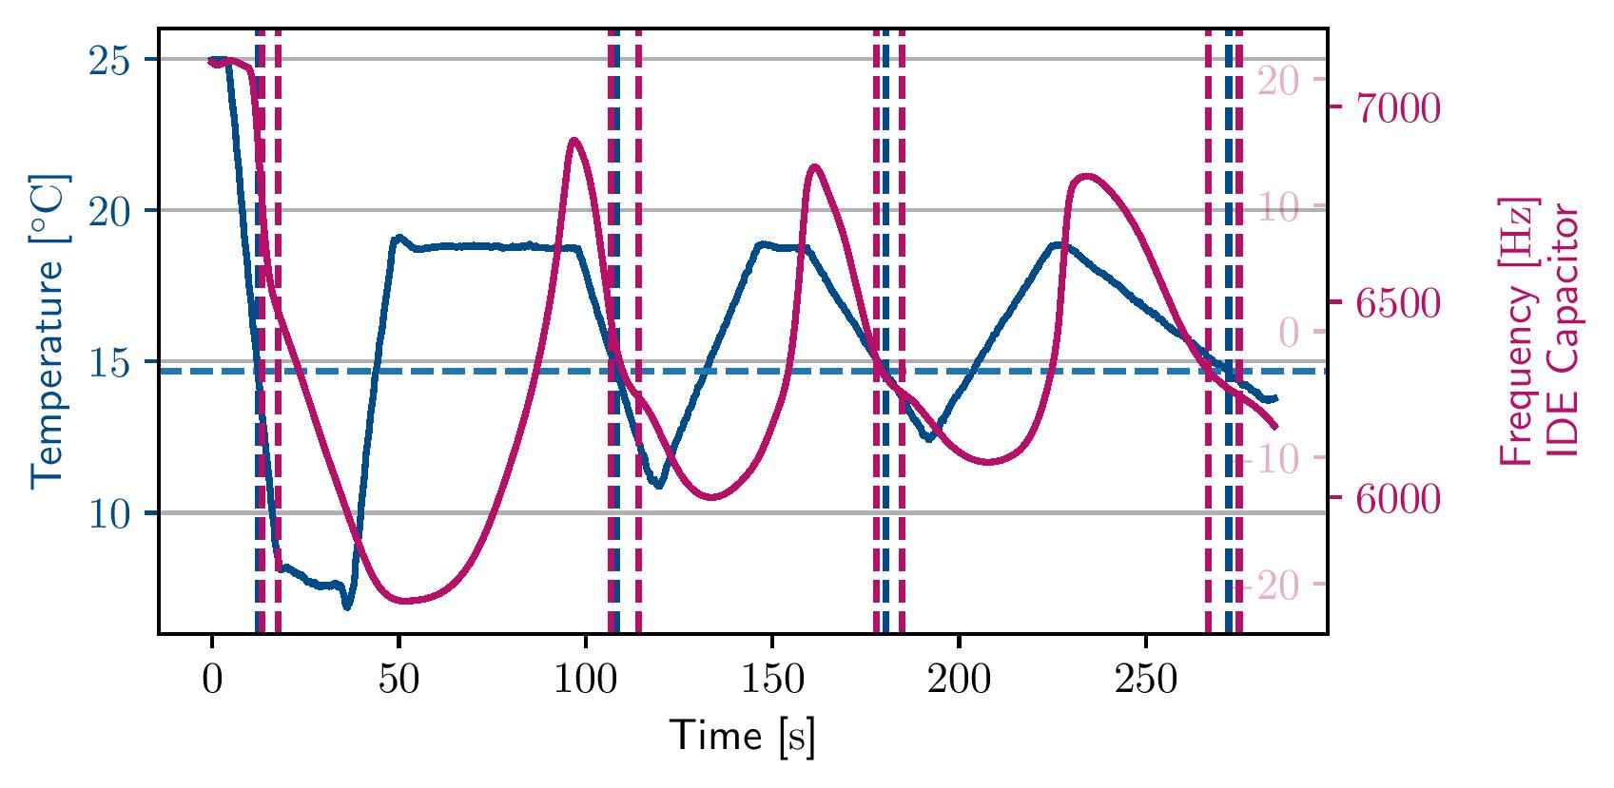
Single Measurement
T=25°C / RH=52.89%

Slide 21
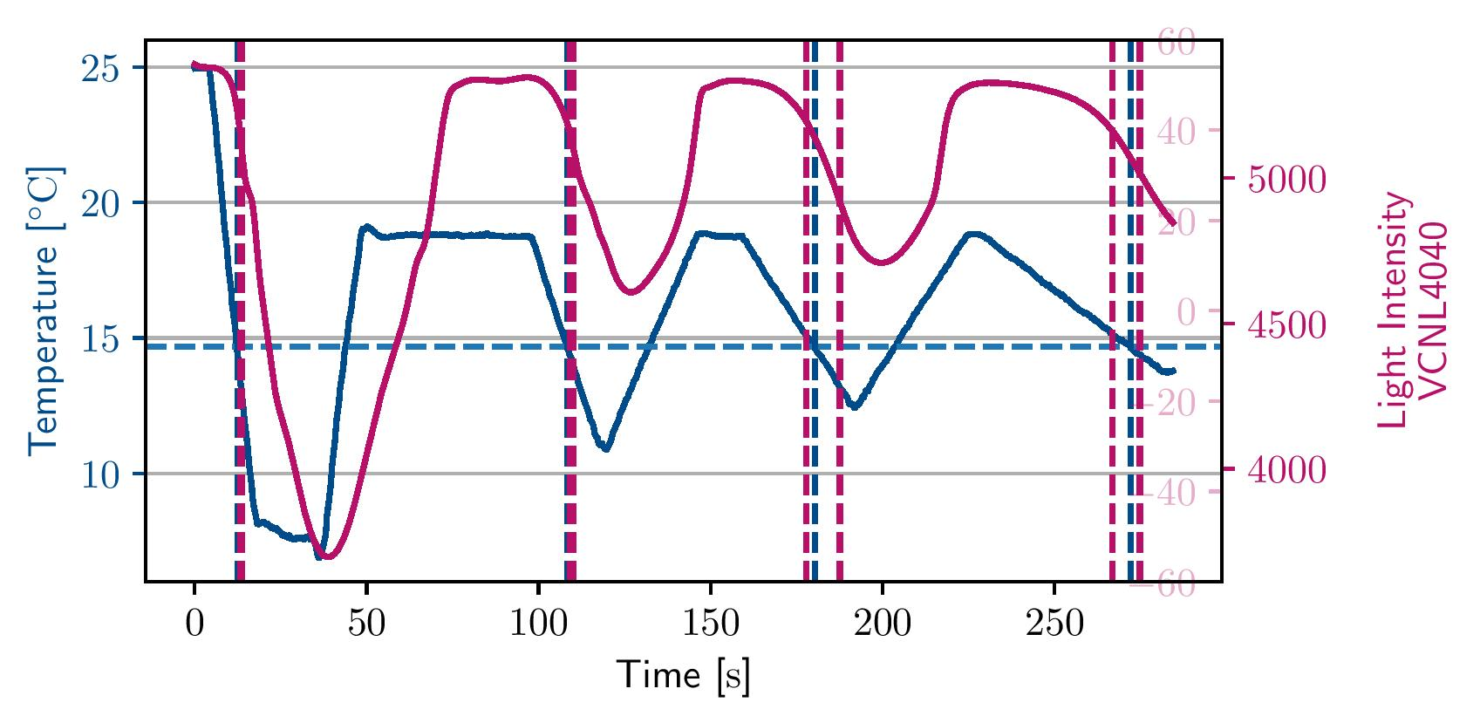
Single Measurement
T=25°C / RH=52.89%

Slide 22
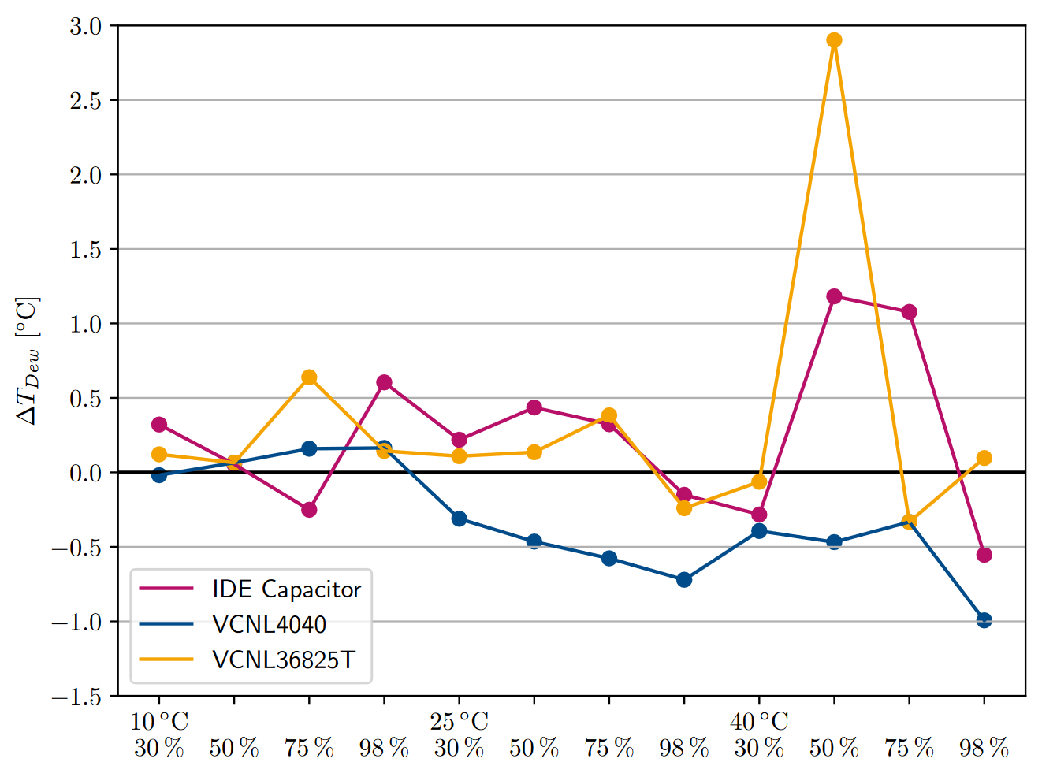
All MeasurementS – Comparison

Slide 23
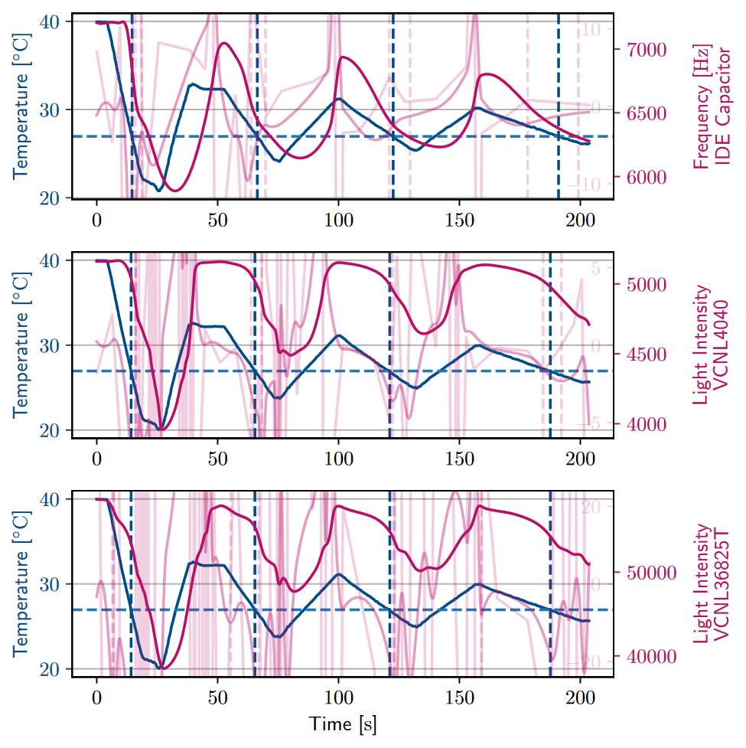
T=40°C / RH=48.4%

Slide 24
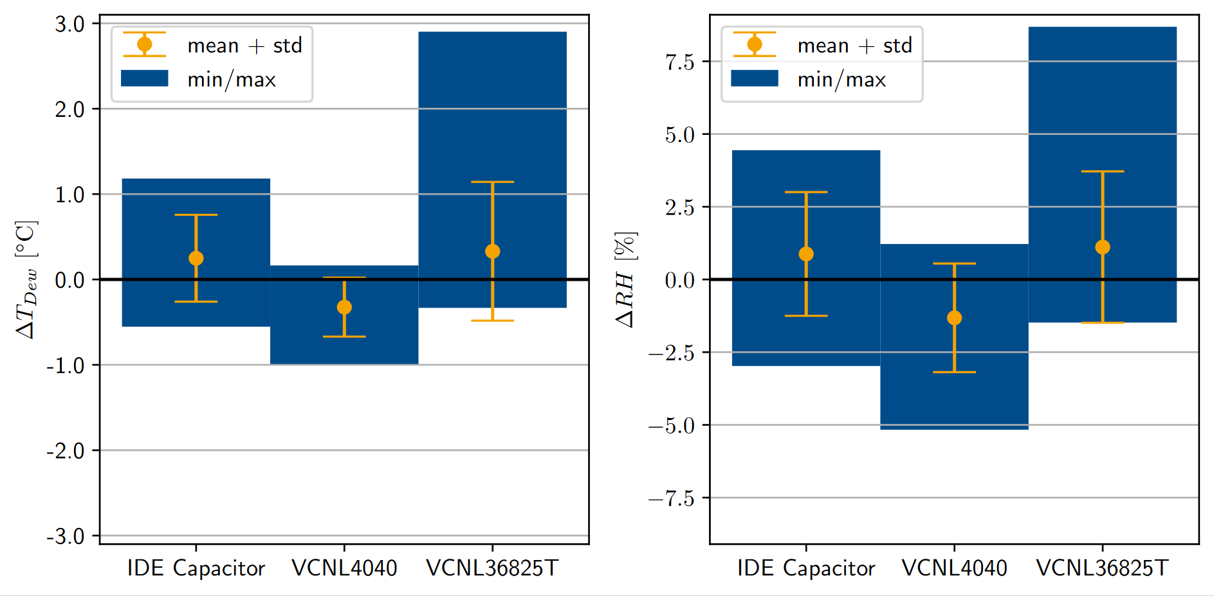
RESULTS

Slide 25
Conclusion
Platform for dew point analysis
Simple mechanical and electronic design
Accuracy:
Similar between IDE capacitor and proximity sensors
Competitive with common integrated capacitive humidity sensors
Order of magnitude less accurate than commercial dew point mirror sensors
Outlook:
Realtime dew point analysis for feedback loop
Data-driven offset reduction
Test setup (constant humidity/temperature)

Slide 26
SOURCES
[1] http://www.atmo.arizona.edu/students/courselinks/fall15/atmo170a1s2/lecture_notes/humidity/condensation_nuclei.html
[2]
L. Greenspan: Humidity Fixed Points of Binary Saturated Aqueous Solutions. Journal of Research of the National Bureau of Standards – A. Physics and Chemistry, Vol. 81A, No. 1, January-February 1977

Slide 27
Discussion
Possible error sources:
Realtime dew point analysis for feedback loop
Data-driven offset reduction
Test setup (constant humidity/temperature)
Temperature dependencies in relaxation oscillator
Uneven temperature distribution

Slide 28
Discussion
Possible error sources:
Missing feedback loop
Missing data-driven offset reduction
Test setup (constant humidity/temperature)
Nonlinearities in proximity sensors
Temperature dependencies in relaxation oscillator
Uneven temperature distribution

Slide 29
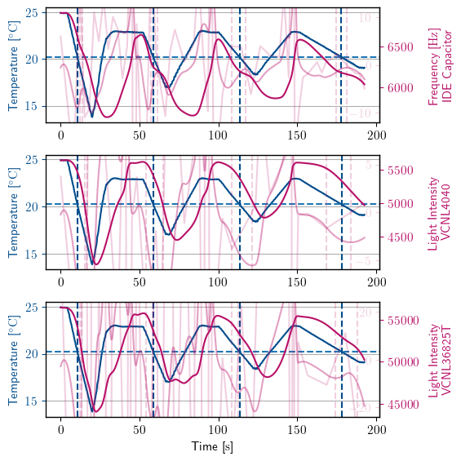
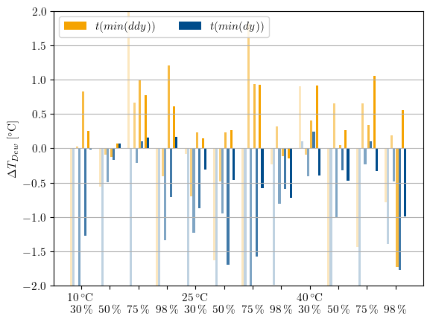
Software - Analysis
Smoothing & Interpolation:
Smoothing splines with variable knot amount
Polynomial interpolation
1st and 2nd order derivatives
Dew Point & RH:
Search for significant points in data
Absolute value depends on RH & temperature
Capacitive:
T(max(ddy))
T(dy=0)
Proximity:
T(min(ddy))
T(min(dy))
Plotting & Comparison:
Notes:
Empirisch, immer abhängig von Steigung oder Änderungsrate der Steigung.

Slide 30
MeasurementS – IDE CAPACITOR (4 cycles)

Slide 31
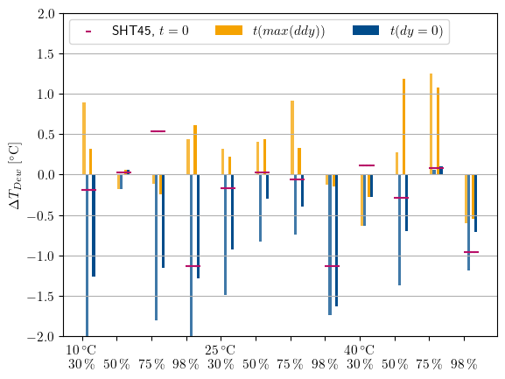
MeasurementS – IDE CAPACITOR (2 cycles)

Slide 32
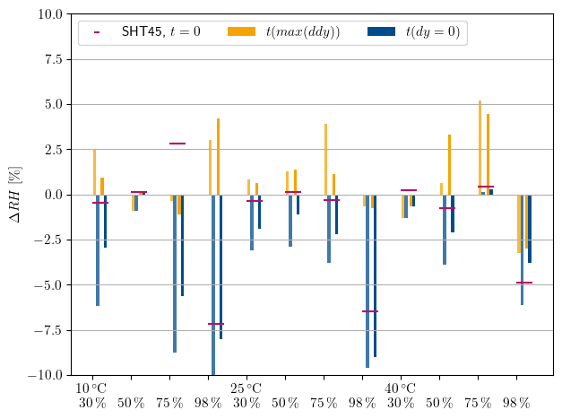
MeasurementS – IDE CAPACITOR (2 cycles)

Slide 33
RESULTS
Based on the average closest point of interest:
IDE capacitor: T(max(ddy))
Proximity sensors: T(min(dy))
Error | T_dew [°C] |  |  | RH [%]
 | IDE | VCNL4040 | VCNL36825T | IDE | VCNL4040 | VCNL36825T
Min | -0.55 | -0.99 | -0.33 | -2.97 | -5.17 | -1.48
Max | 1.18 | 0.16 | 2.9 | 4.44 | 1.22 | 8.69
Avg | 0.25 | -0.32 | 0.33 | 0.88 | -1.32 | 1.11
Std | 0.51 | 0.34 | 0.81 | 2.12 | 1.86 | 2.60

